Slide 1
Lung cancer staging and screening
MED275 – September 25, 2024
Natalie Lui, MD Assistant Professor of Cardiothoracic Surgery
Surgical Director, Lung Cancer Screening Clinic
Associate Medical Director, Stanford Cancer Center

Slide 2


Lung cancer causes more deaths than any other cancer
CA Cancer J Clin 2024;74:12-49.

Slide 3
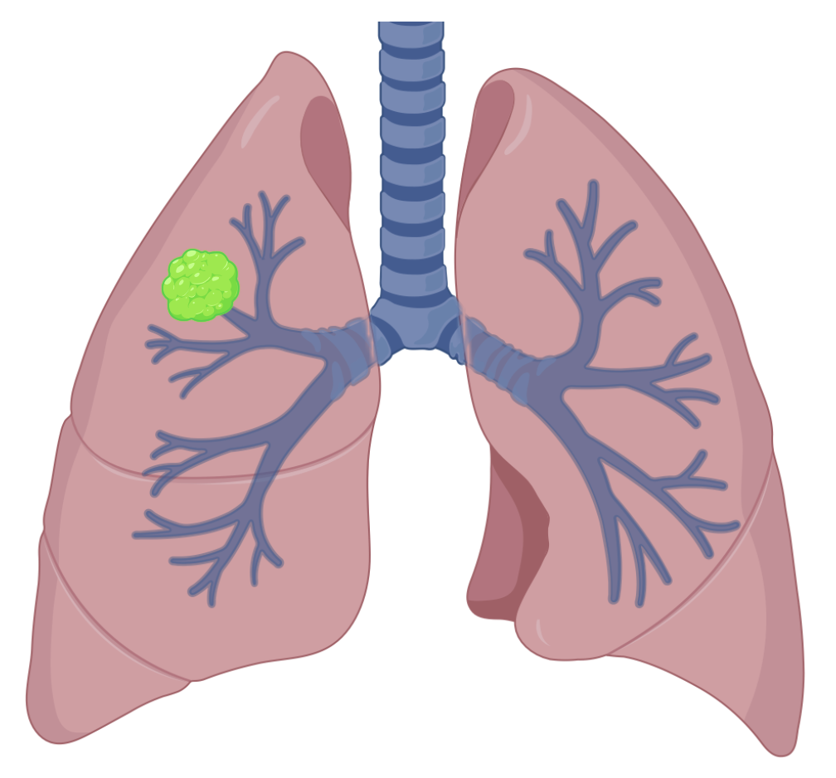
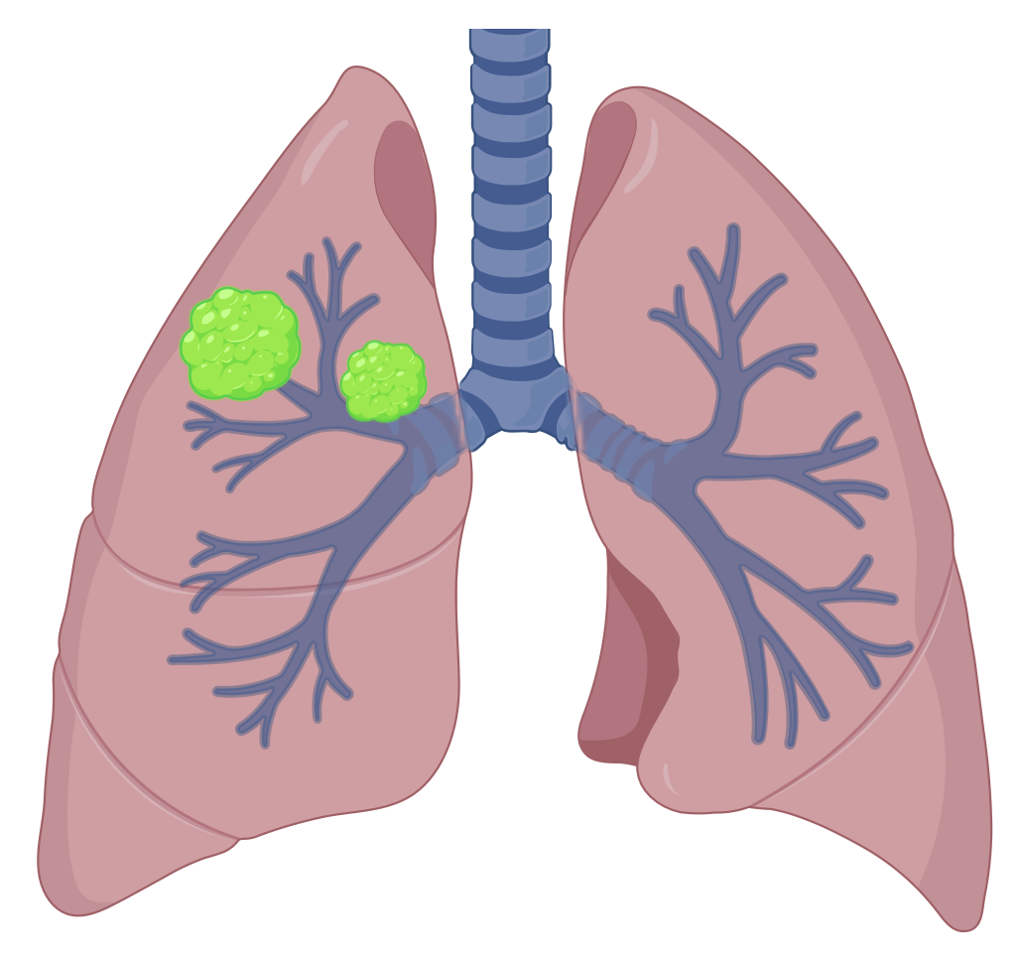
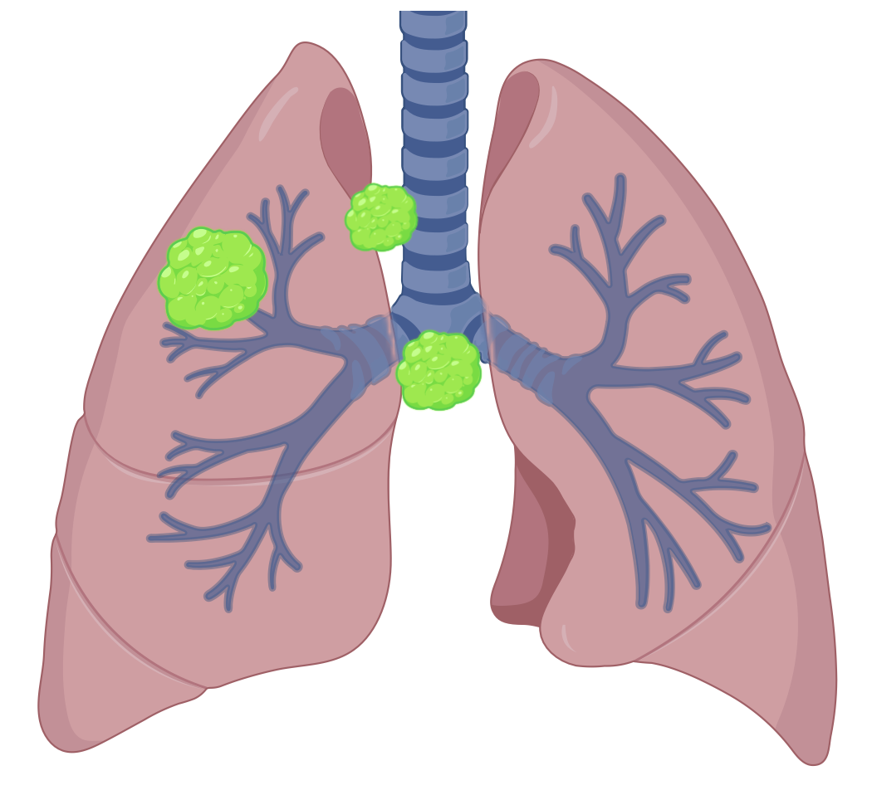
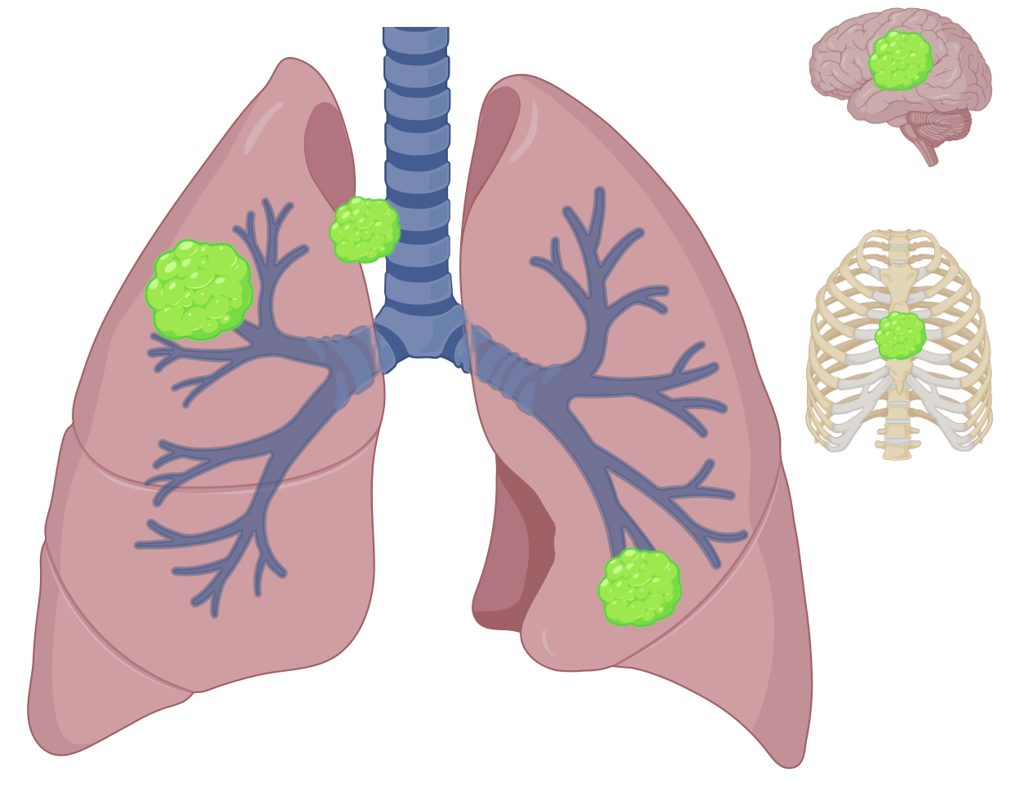
Lung cancer is usually diagnosed when it is advanced
I
II
III
IV
Cancer 208;124(13):2785-2800.
CHEST 2017;151(1):193-203.
Created with BioRender

Slide 4
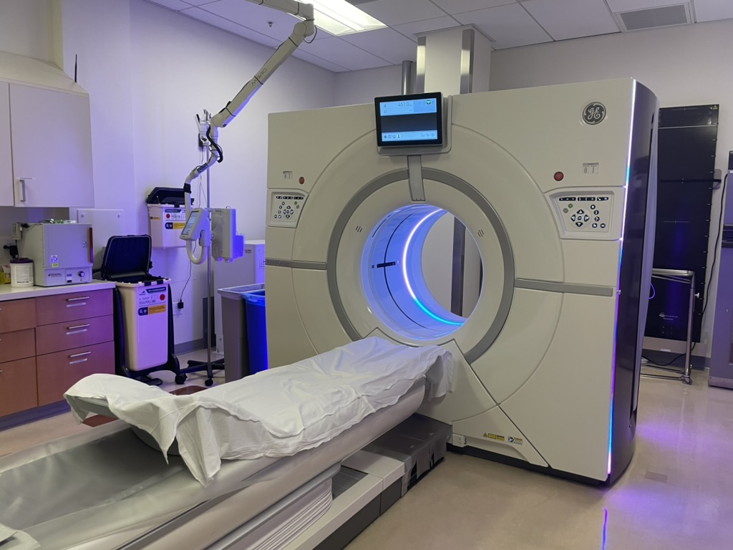
Lung cancer screening saves lives
Annual low dose computed tomography (LDCT)
Recommended for heavy smokers
50-80 years old
At least 20 pack-years smoking history
Current smokers or quit within 15 years
Smoking cessation, if applicable
N Engl J Med 2011;365:395-409.
N Engl J Med 2020;382:503-13.

Slide 5
What is a pack-year?
Pack-year = number of packs smoked per day x number of years smoked
Many different ways to reach 20 pack-years
For example,
Someone who smoked 1 pack per day for 20 years has 1 x 20 = 20 pack-years
Someone who smoked 2 packs per day for 10 years has 2 x 10 = 20 pack-years

Slide 6
National Lung Screening Trial
53,454 participants
55-74 years old
At least 30 pack-years smoking history
Current smokers or quit within 15 years
Three annual screenings, either
Low dose computed tomography (LDCT) OR
Chest x-ray (CXR)
Lung cancer detection rate was 1.1% after first scan
50% of lung cancer cases were stage 1
Annual LDCT decreased lung cancer mortality by 20%
For every 320 scans, one lung cancer death prevented
N Engl J Med 2011;365:395-409.

Slide 7
Lung-RADS
Lung-RADS | Descriptor | Estimated prevalence | Management
0 | Incomplete | 1% | Comparison to prior CT
1 | Negative | 39% | Annual LDCT
2 | Benign | 45% | Annual LDCT
3 | Probably benign | 9% | 6-month LDCT
4A | Suspicious | 4% | 3-month LDCT or PET/CT
4B | Very suspicious | 2% | PET/CT or tissue sampling
4X | Additional imaging findings that increase the suspicion for lung cancer | <1% | PET/CT or tissue sampling
S | Significant or potentially significant finding unrelated to lung cancer | 10% | As appropriate
N Engl J Med 2011;365:395-409.

Slide 8
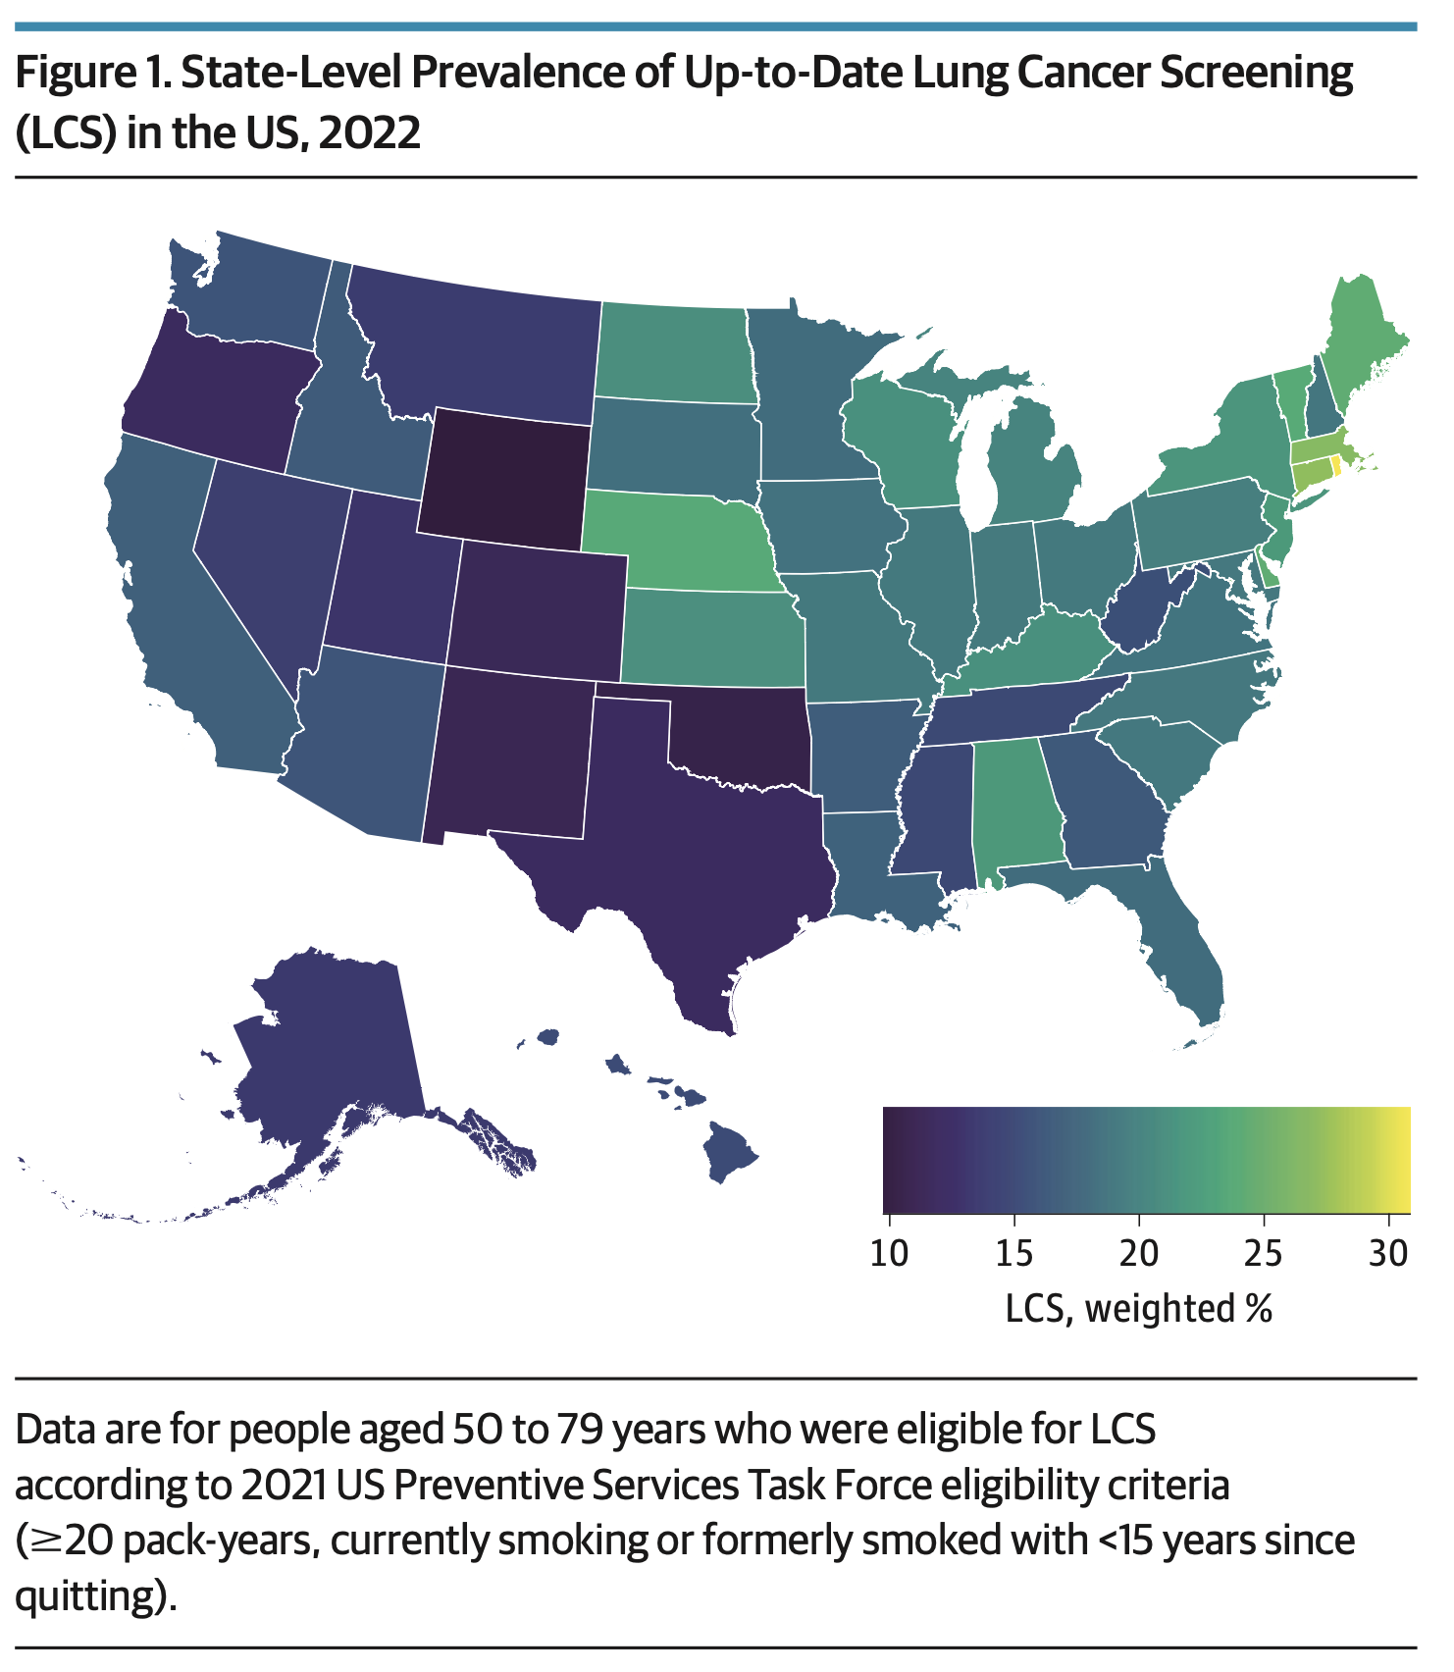
Lung cancer screening implementation has been challenging
JAMA Intern Med. 2024;184(8):882-891.

Slide 9
Risks of lung cancer screening
Radiation exposure
False positives
Overdiagnosis
Incidental findings
Cost
Anxiety
JAMA Intern Med. 2024;184(8):882-891.

Slide 10

Lung cancer in Asian people is different
EGFR
Mutations
Adenocarcinoma
Never
smokers
Groundglass
nodules

Slide 11




Asian Americans with lung cancer
Genetics
Secondhand smoke
Air pollution
Cooking oil fumes
Lung Cancer 2022;174:50-56.

Slide 12
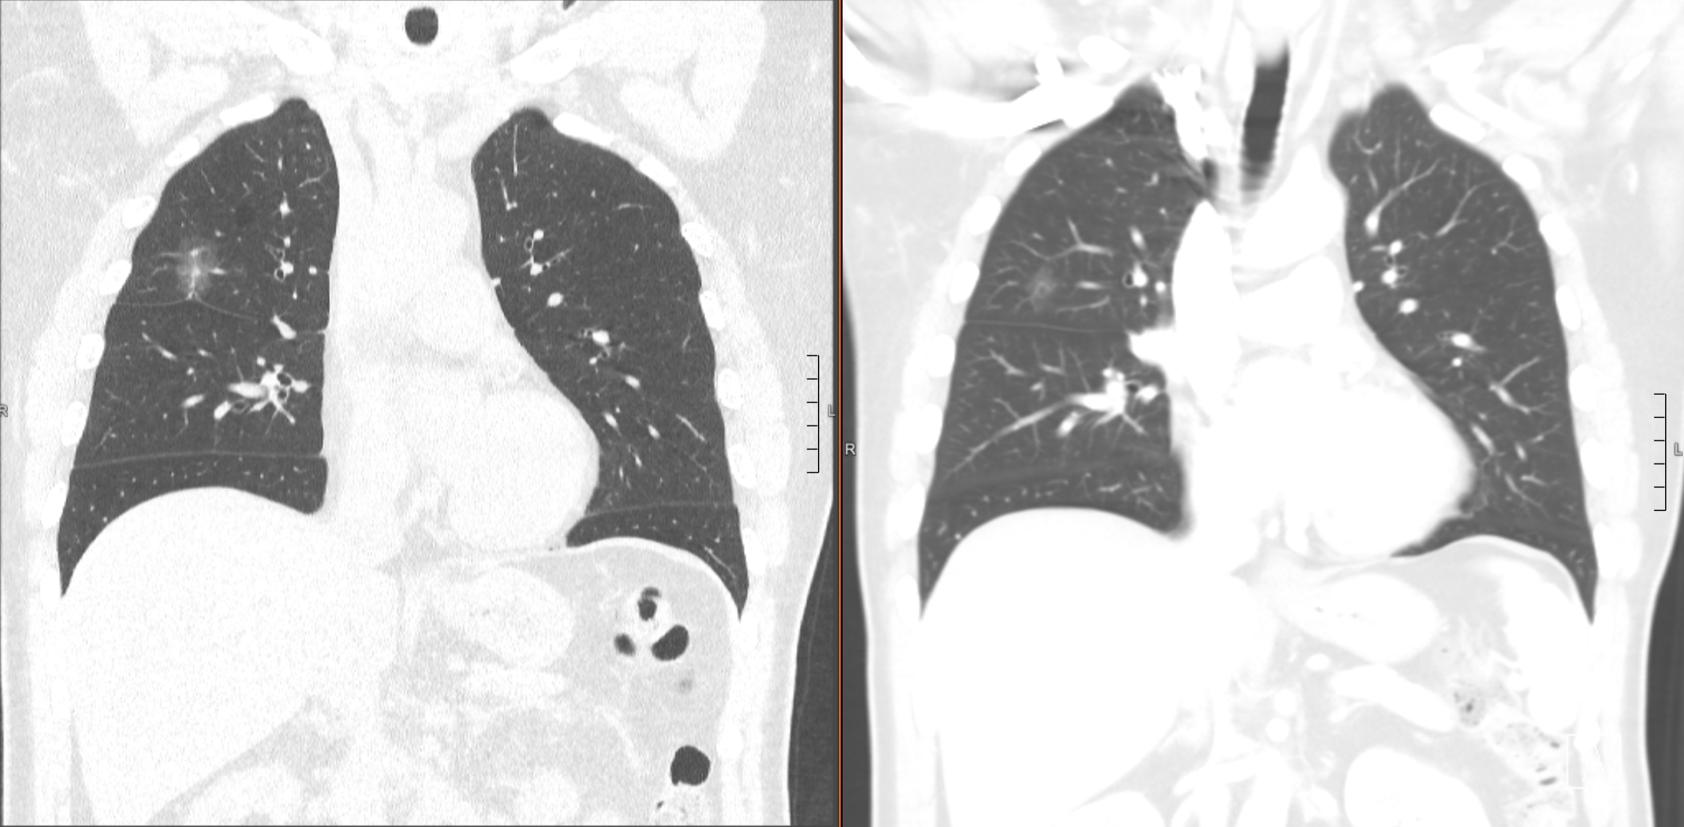
Groundglass nodules

Slide 13

Taiwan TALENT study
12,011 participants
55-75 years old
Never or light past smokers
At least one additional risk factor: family history, cooking oil exposure, secondhand smoke
LDCT annually for 3 years, then every 2 years for 6 years
Detection rate was 2.1% after first scan
52% of lung cancer cases were stage I
All but one were adenocarcinoma
Detection rate was 2.7% in participants with family history
Early Detection Program 2022
50-74 years old for men and 45-74 years old for women
Never or light past smokers
Family history of lung cancer
LDCT every 2 years
Lancet Respir Med 2024;12:141-52.

Slide 14
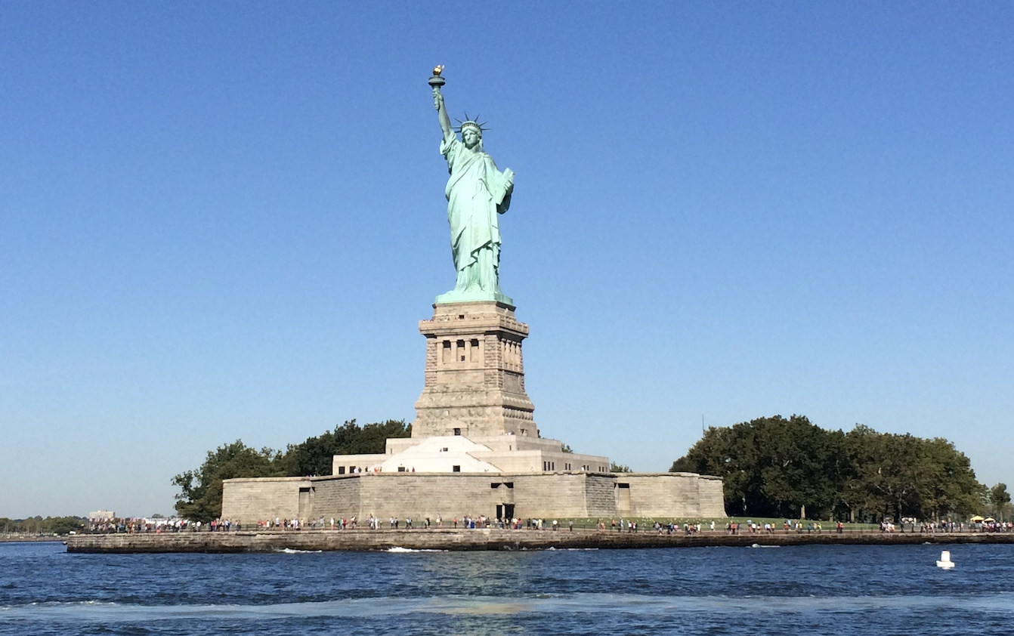
NY Female Asian Nonsmoker Screening Study (FANSS)
201 participants and still enrolling
Women
40-74 years old
Never smokers
Identify as from Asian descent
Low dose computed tomography (LDCT) annually for 3 years
Detection rate for lung cancer was 1.5%
All had EGFR mutations
Detection rate for groundglass nodules was 14%

Slide 15
Thanks

